Slide 1
Power Query & Power Pivot in Excel
C.K.Leng

Slide 2
Class Schedule
Duration: 3 Days
Training Hour: 9am ~ 5pm
Short Breaks:
  Morning: 10:30am~10:45am
  Afternoon: 3:30pm~3:45pm
Lunch Break: 12:30pm~1:30pm (Friday 2:30pm)

Slide 3
Your Instructor
LENG Chee Kong
ckleng1964@gmail.com
019-21333329
https://my.linkedin.com/in/chee-kong-leng/en-us

Slide 4
Course Supporting Site
https://ExcelCourses.AzureWebsites.net/XL8001

Slide 5
Environment Setup
MS Windows 10 or Higher
MS Office 2019 or Higher
MS SQL Server
  Data Engine
  Management Studio

Slide 6
Introduction
Self-Service Business Intelligence (BI)
Driving Factor
  Speed of BI
  Changing analytical needs - demand more dynamic predictive analysis
  More power users
The Power 4
  Power Pivot
  Power Query
  Power View
  Power Map

Slide 7
Thinking Like a Database
Databases
Tables
Fields
Query
Entity Integrity and Referential Integrity
Relationship
  Primary Key
  Foreign Key
  Cardinality

Slide 8
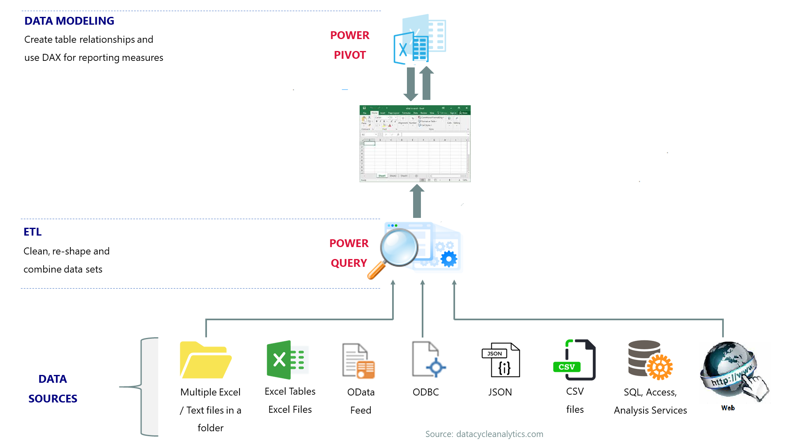
Power Pivot and Power Query in Excel

