Slide 1
Introduction
XL682:
Descriptive Analytics with Excel
Notes:
20778C
1: Introduction to Self-Service BI Solutions

Slide 2
Your Instructor
LENG Chee Kong
ckleng1964@gmail.com
0192133329

Slide 3
Training Schedule
Duration: 2 Days Training Hours: 9am~5pm Lunch Break:
Monday ~ Thursday: 12:45pm~1:45pm (1 Hour)
Friday: 12:30pm~2:30pm (2 Hours)
Short Breaks:
Morning: 10:30am~10:45am
Afternoon: 3:30pm~3:45pm
Notes:
20778C
1: Introduction to Self-Service BI Solutions

Slide 4
What is BI?
Wisdom
Knowledge
Information
Data
BI
DBMS

Slide 5
Business intelligence scenarios
Big data is the result of data generated by the internet, social media, and e-commerce:
Data is constantly being gathered for commercial use
Data is constantly growing in size
Reporting:
Extracting data and presenting it to enable decision-making
Show metrics for organizational performance
Analysis:
Evaluating data to discover insights
Data should answer questions, but quickly becomes outdated
Collaboration:
Business analysts need to share data for decision-making
Notes:
20778C
1: Introduction to Self-Service BI Solutions

Slide 6
Trends in business intelligence
BI trend is moving away from analyzing historical data, towards real-time analytics and predictions:
Self-service reporting and analysis:
Self-service has existed since the invention of spreadsheets
Widespread adoption of Excel and the use of power tools
Enables independence from IT, quick to produce reports
Increasing adoption of BI:
Organizations of all sizes gathering data and statistics
Essential to react to trends and remain competitive
Availability of out-of-the-box solutions:
Solutions from Tableau, Qlik, Microsoft, Salesforce, and so on
Some have large license fees and may require trained report developer
Notes:
20778C
1: Introduction to Self-Service BI Solutions

Slide 7
Power 4
Power Query
Power Pivot
Power View
Power Map

Slide 8
Process in using Power 4
Link to Data Source
Load Data
Establish Relationship
Prepare Report
Transform Data
Prepare Dashboard
Share

Slide 9
Business intelligence project roles
Developing BI solutions requires upfront planning
Each role in the project performs a vital function:
Program manager
Data architect
Technical architect
BI developer
Notes:
The role of the data steward is covered in a later topic.
20778C
1: Introduction to Self-Service BI Solutions

Slide 10
Enterprise BI data models
Create a consistent view of data elements and their relationships in the organization
Set standards and use naming conventions
Comprise a logical and physical model
Semantic model gives meaning to the data
Notes:
20778C
1: Introduction to Self-Service BI Solutions

Slide 11
Introduction to data analysis
Data sources Queries Data transformations Visualization
Notes:
20778C
1: Introduction to Self-Service BI Solutions

Slide 12
Data sources
The location, or repository, of the data for your BI solution
Traditionally used ETL process, now held:
On-premises
In the cloud
In files
Notes:
20778C
1: Introduction to Self-Service BI Solutions

Slide 13
Queries
Commands you run against the data source to specify the data to extract:
Return entire tables or run a query against the source
Use stored procedures against SQL Server databases
Only return the data that you need
Expressions used to transform data:
M Query Language:
Use in Power Query Editor
Generate using menu options or edit query directly
DAX:
Derived from MDX and Excel formulas
Straightforward to use but very powerful
Notes:
Data transformations are introduced in more detail in the next topic. Module 4 of Course 20778C, Shaping and Combining Data, explains how to implement data transformations using menu options and M in Power Query Editor. Module 5 of Course 20778C, Modeling Data, explains how to use DAX.
20778C
1: Introduction to Self-Service BI Solutions

Slide 14
Data transformations
Data must be transformed from its form in the data source into a compatible format for your reports:
Cleaning
Formatting
Notes:
20778C
1: Introduction to Self-Service BI Solutions

Slide 15
Visualization
Human eye recognizes patterns
Easier to see anomalies in charts and maps than tables
Visualizations reveal patterns, clusters, and outliers
Help make fast decisions about data
Eliminates the need for the brain to process raw numbers
Notes:
Chart types are covered in detail in the next lesson, so don’t spend too much time discussing them here.
20778C
1: Introduction to Self-Service BI Solutions

Slide 16
Introduction to data visualization
Charts Cards Maps Tables Tree maps Formatting charts
Notes:
Remember that this lesson is an introduction to visualization. Some of the chart types are discussed in more detail later in the course.
20778C
1: Introduction to Self-Service BI Solutions

Slide 17
Overview of self-service BI
Data explosion Limitations of managed enterprise BI Self-service BI trend
Notes:
20778C
1: Introduction to Self-Service BI Solutions

Slide 18
Self-service BI trend
Big data:
Less about being big, more about an organization’s ability to extract useful insights
Users need to combine data from various sources
Data analysis needs to be done quicker
Self-service BI:
Business users can access corporate data and perform analysis without possessing technical skills
Popularity driven by:
Excel Power Tools (Power 4)
Power BI
Increase in affordable solutions from software vendors, such as Tableau and Qlik
Notes:
Question
Given what you have learned so far in this module, regarding the limitations of managed BI and the uptake of self-service BI with all its advantages, do you think there is a future for managed BI?
20778C
1: Introduction to Self-Service BI Solutions

Slide 19
Microsoft tools for self-service BI
SQL Server Reporting Services Excel SharePoint Online Power BI Desktop Power BI Report Server
Notes:
20778C
1: Introduction to Self-Service BI Solutions

Slide 20
SQL Server Reporting Services
Part of the SQL Server family:
Reporting element of the Microsoft BI stack
Installed on stand-alone, dedicated server
Secured using Windows Authentication/AD
Reports created by:
SSRS developers using Report Designer in Visual Studio
Business users using Report Builder
Data cached on server to speed report generation
Users subscribe to report schedules
Notes:
20778C
1: Introduction to Self-Service BI Solutions

Slide 21
Excel
The addition of the 4 power tools to Excel was the key driver in growing the self-service BI trend:
Power Pivot: work with millions of rows, model data with DAX, create relationships, measures and KPIs
Power Query: renamed Get & Transform in Excel 2016. Import data from external data sources, including local files, on-premises and cloud databases, SaaS providers, and Hadoop. Transform, format, and combine data. Share queries using Power BI Data Catalog
Power View: create interactive visualizations, drill down into data, create new relationships, and KPIs
Power Map: allow visualization geographical related data with maps
Notes:
20778C
1: Introduction to Self-Service BI Solutions

Slide 22
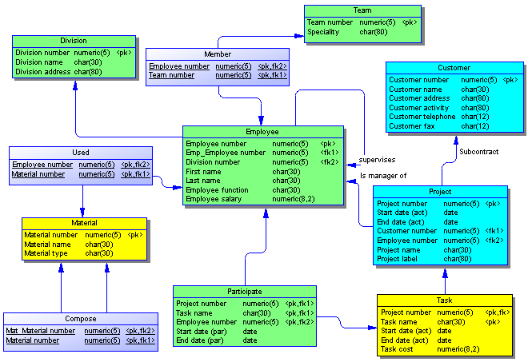
Data Loading
Common Data Sources
Power Query
Data Model

Slide 23
Important Concepts
Relationship
Referential Integrity
Foreign Key and Primary Key
Cardinality (Multiplicity)

Slide 24
What’s Next?
Explore more Visual Elements and learn how to use each of those elements properties
Study deeper the DAX
If Direct Query is needed, learn SQL’s Select statements (www.w3schools.com/sql)

